Slide 1
final project
Group6
Team members：
Kaijun Xie
Dongwei Wang
Zhicong Wang
Guanjun Wang

Slide 2
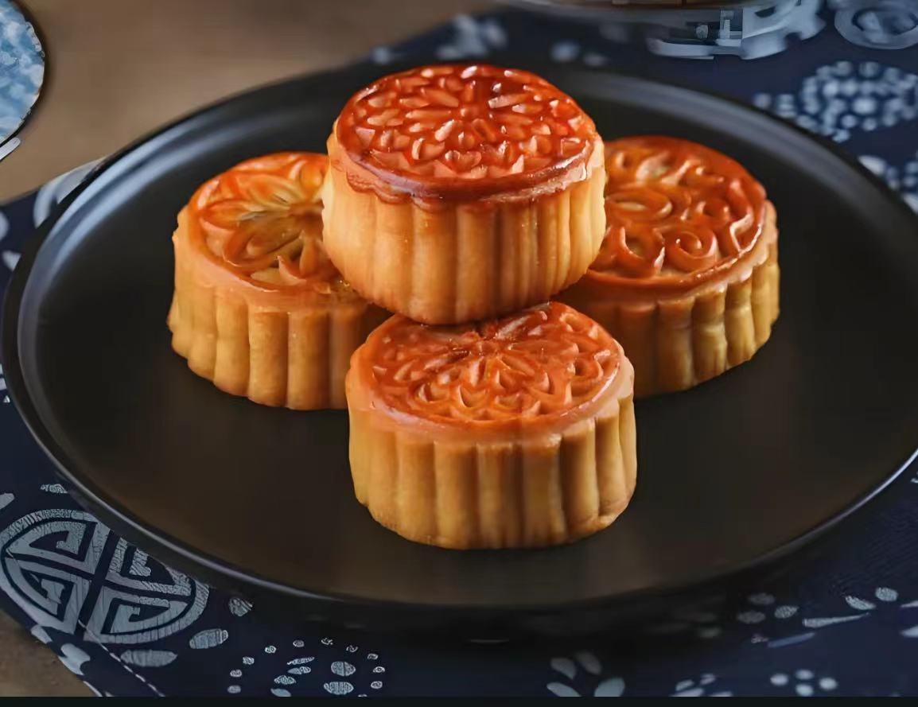
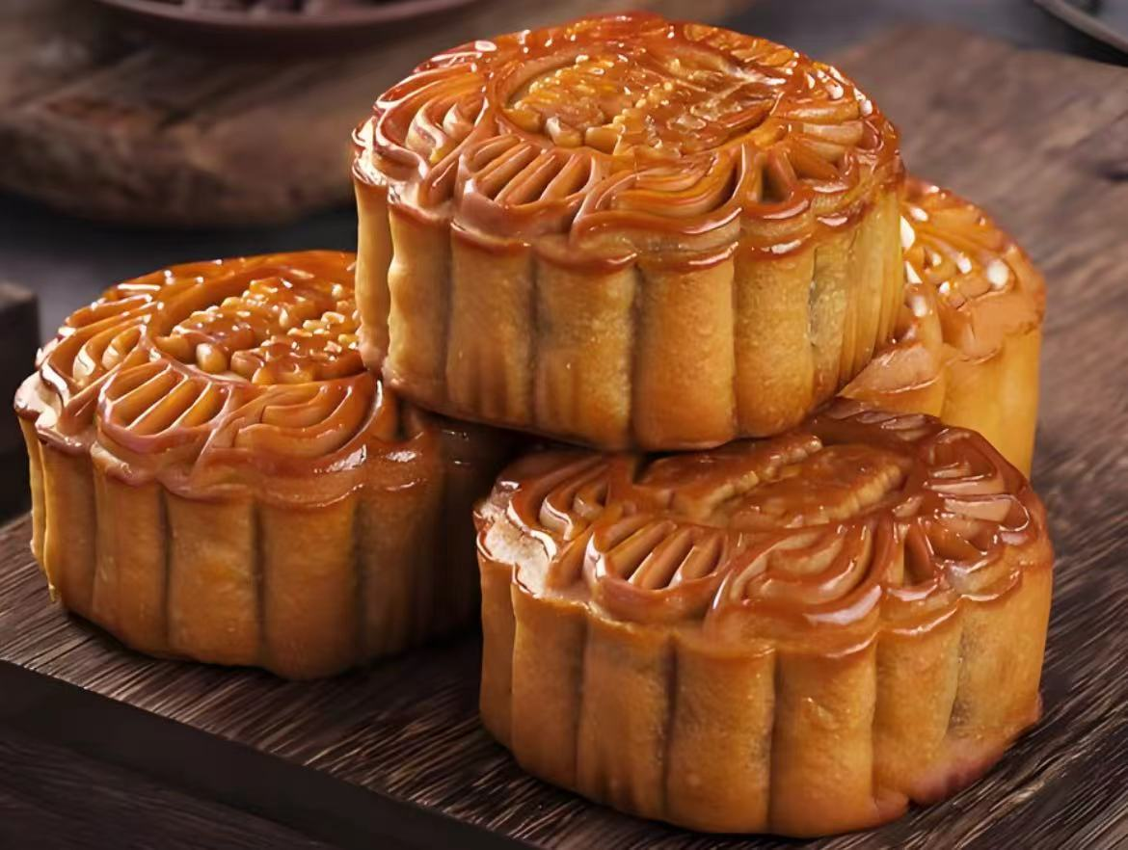
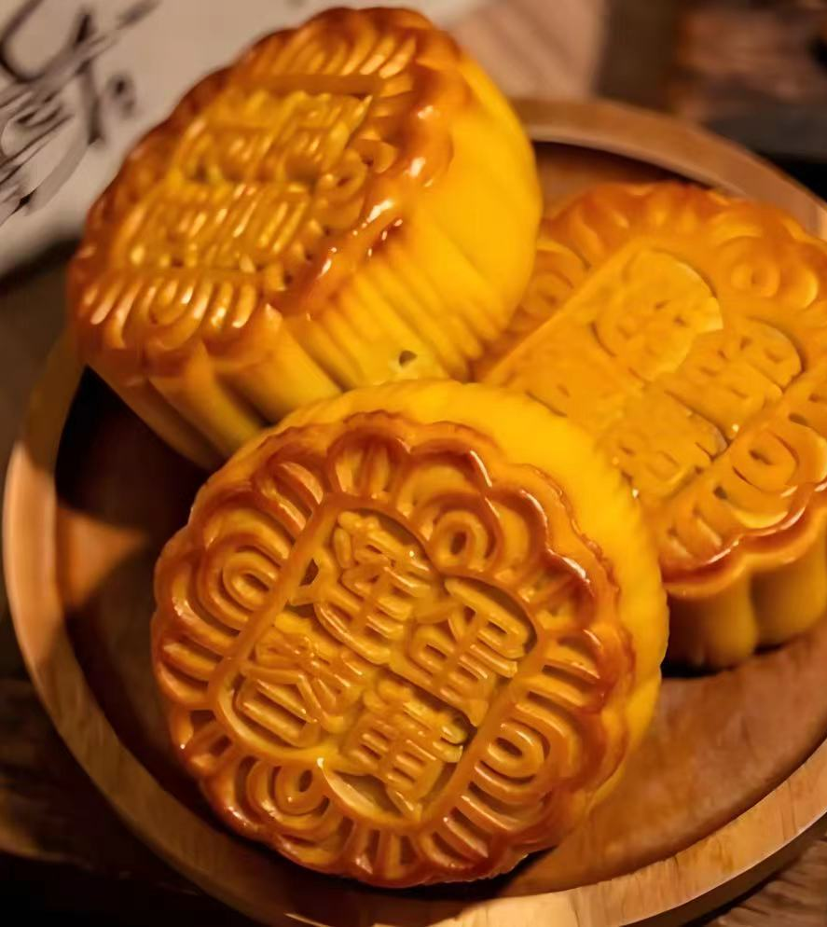
ABOUT PROJECT
Mooncake is one of the representative foods in Chinese traditional culture, carrying deep cultural significance and festive atmosphere. As an important symbol of the Mid-Autumn Festival, mooncake is not only a kind of food, but also a carrier of cultural inheritance, symbolizing reunion, beauty and blessing. The core goal of this project is to use OpenSCAD to build a highly detailed 3D model of a mooncake, including elements such as the base form, side patterns, top decorations (e.g., tai chi patterns), and text engravings. Through accurate geometric modeling, we hope to reproduce the real appearance of the mooncake in the digital world.

Slide 3
RESPONSIBLE PARTOF PROJECT
Kaijun Xie
Dongwei Wang
Zhicong Wang
Guanjun Wang

Slide 4
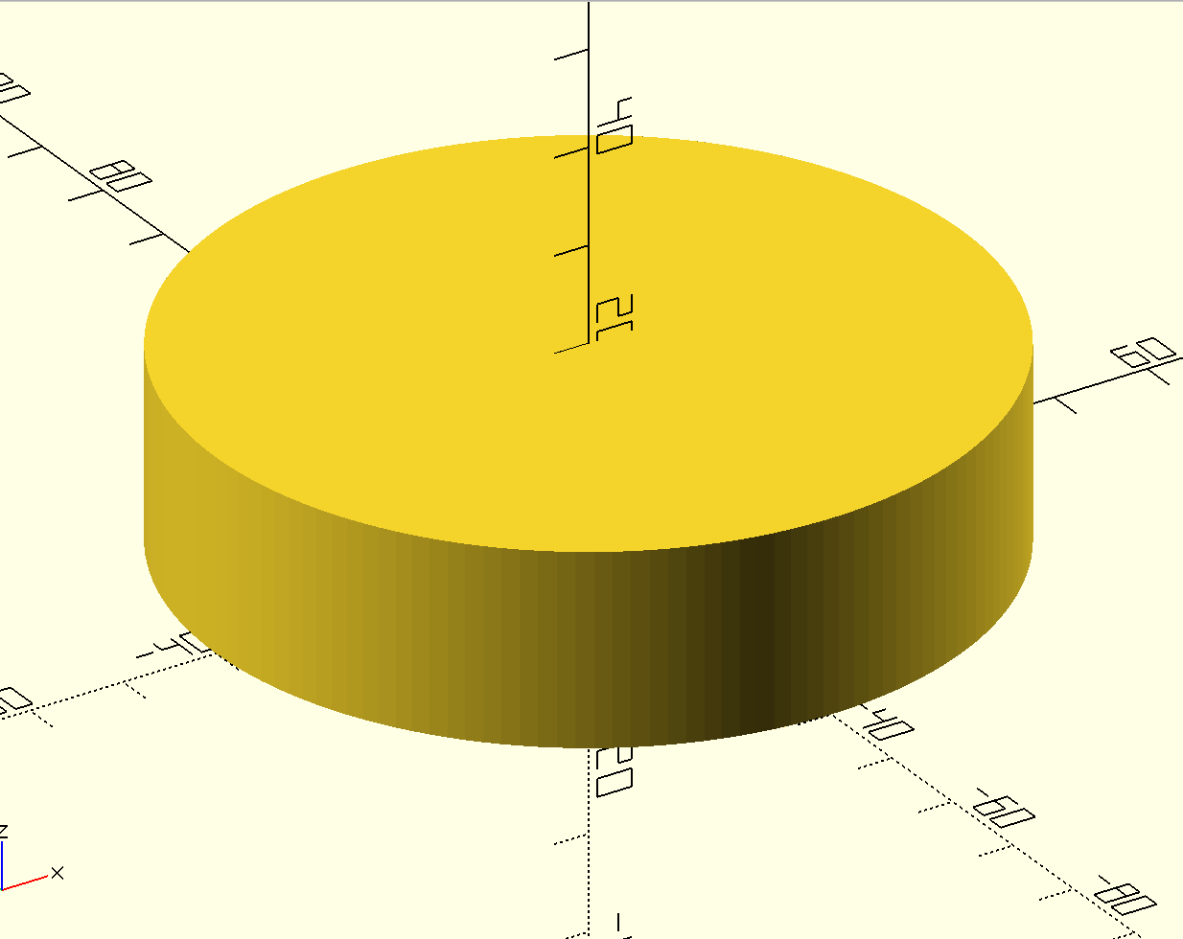
MODELING PROCESS
Step 1: Create the Mooncake Body
In this step, we will create the basic shape of the mooncake, which is a cylinder.

Slide 5
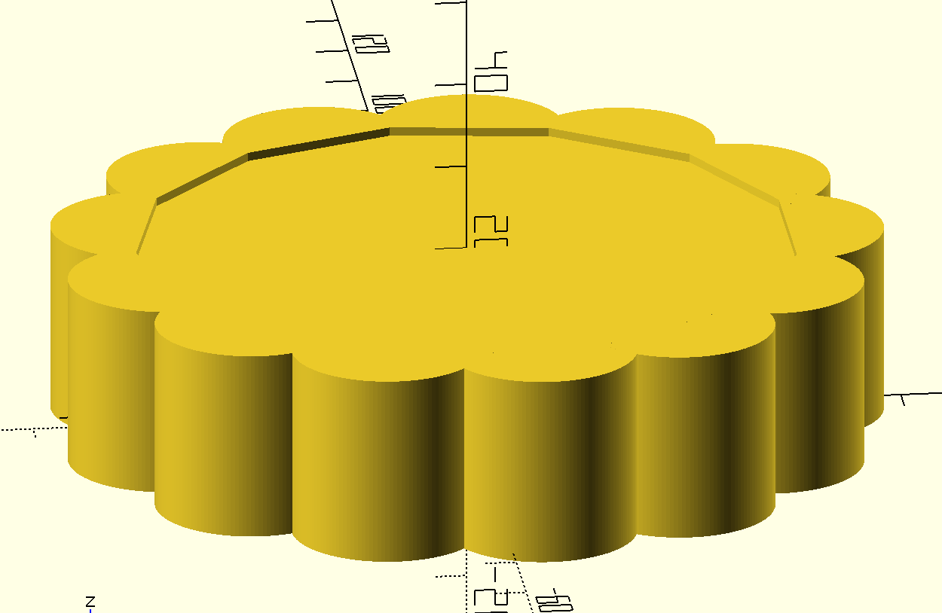
Step 2: Add Patterns
In this step, I will add vertical patterns to the mooncake body, making it more real
Explanation
In this step, we define a function called pattern that creates a pattern on the side of the mooncake. We
then use a loop to add multiple patterns around the mooncake body.

Slide 6
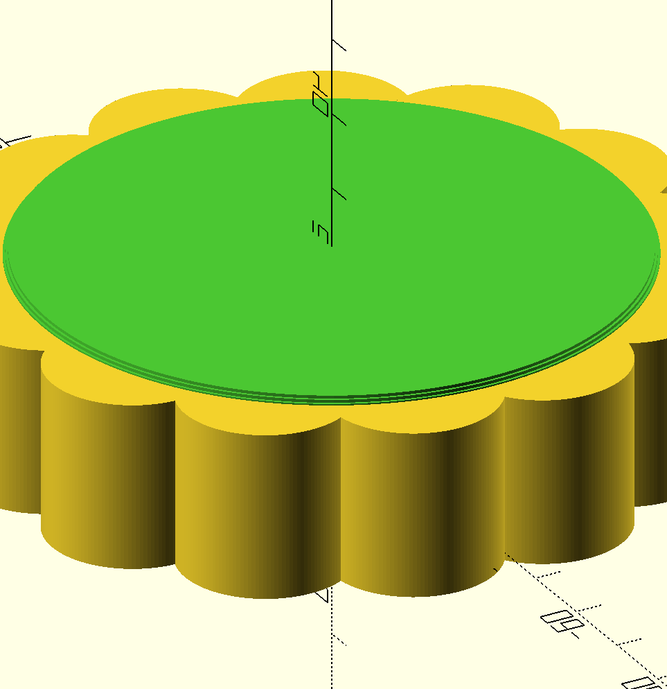
Step 3: Adding Top Patten
In this process, I create a circular truncated cone at the top of cylinder. This function like a stander for
subsequent patten on mooncake, including text and TaiJi patten.

Slide 7
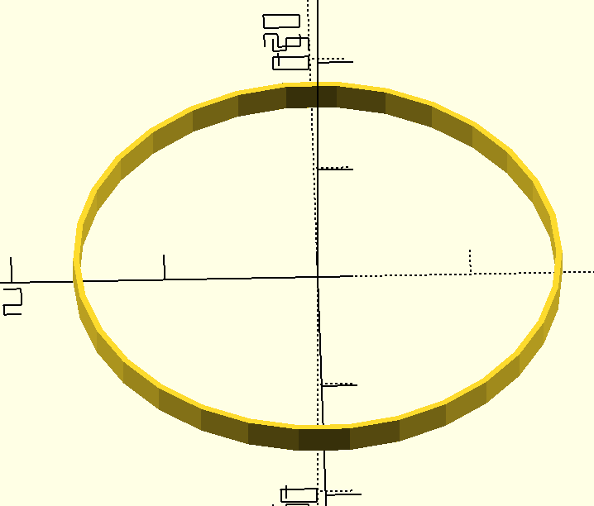
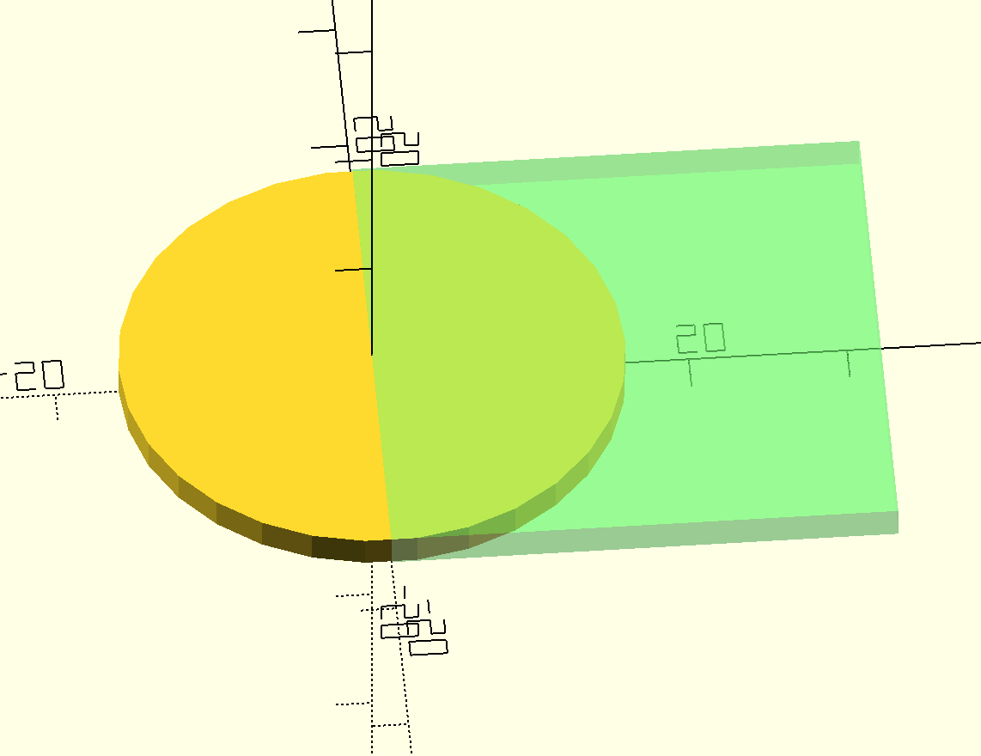
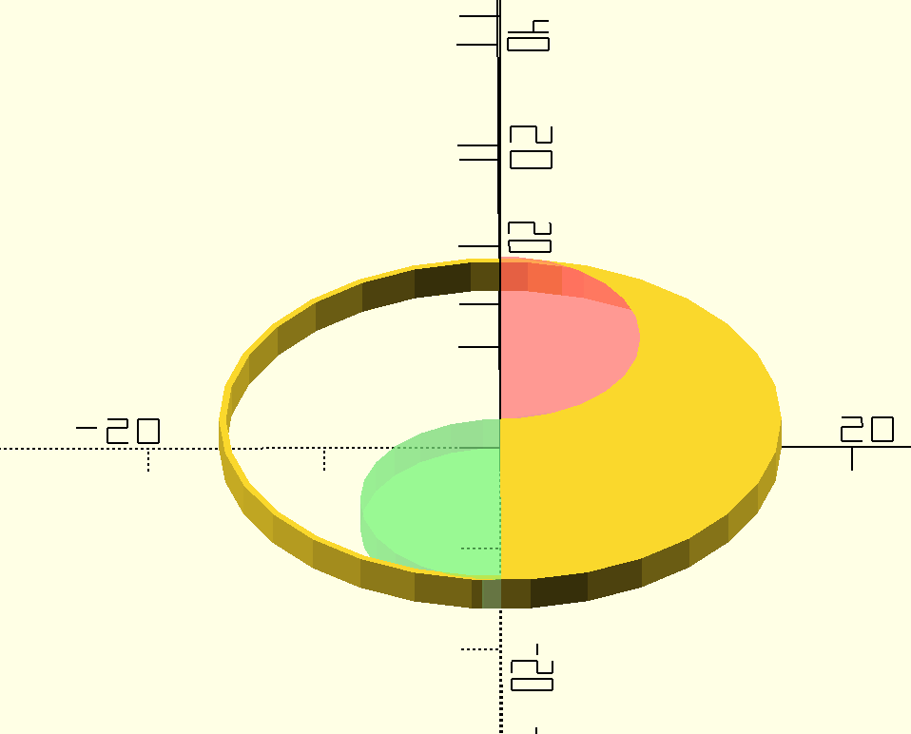
Step 4: TaiJi patten
This is the most complicated part of this project. We need to use multiple boolean operations such as difference, intersection
The design of Tai chi patterns needs to go through the following stages:
the half circle is created by interscting a circle and a square on circles' one side. 2.2 union or difference two small circle. Similarly we can create two little half circle, but one is Union to the main half circle another is Difference. Explain.
union or difference two small circle. Similarly we can create two little half circle, but one is Union to the main half circle another is Difference. Thus, we can get the final image demonstration.
1. Create basic structure By this process, an annulus is created, Annuls is used to make sure lower part of TaiJi is obvious.

Slide 8
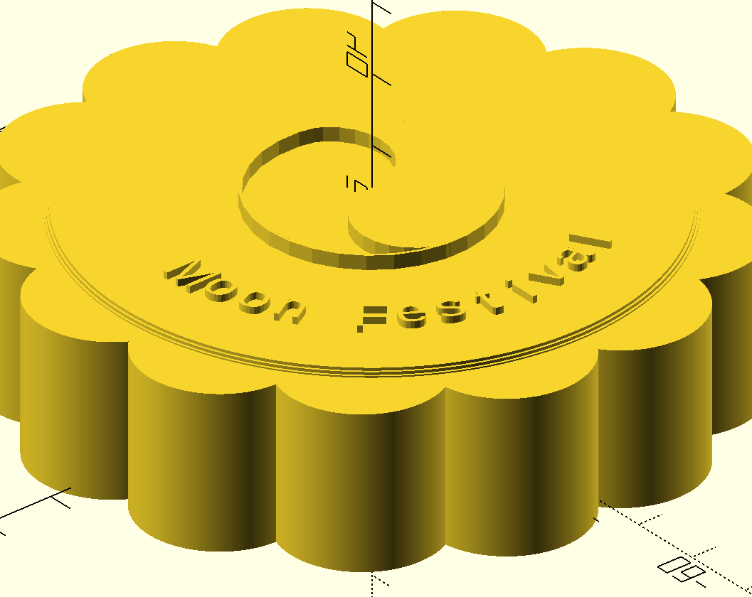
Step 4:Finish Up
After adding some text on it, and render,we can get this image about mooncake.

Slide 9
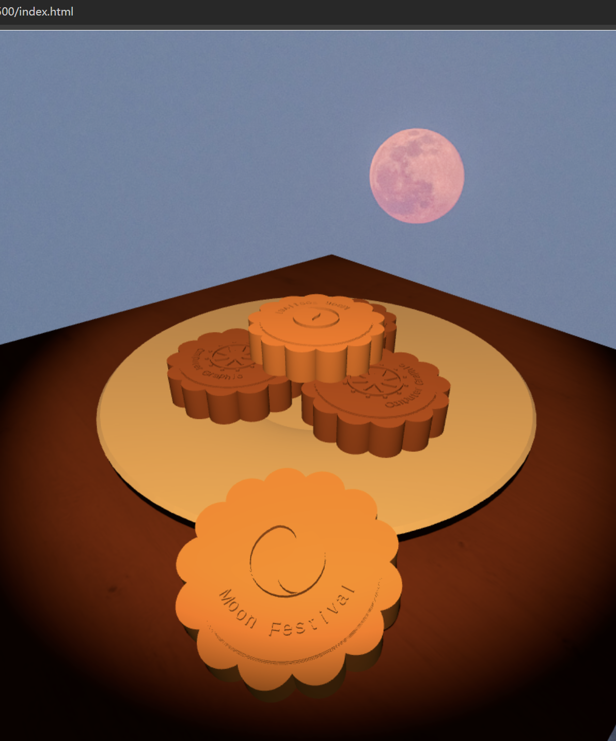
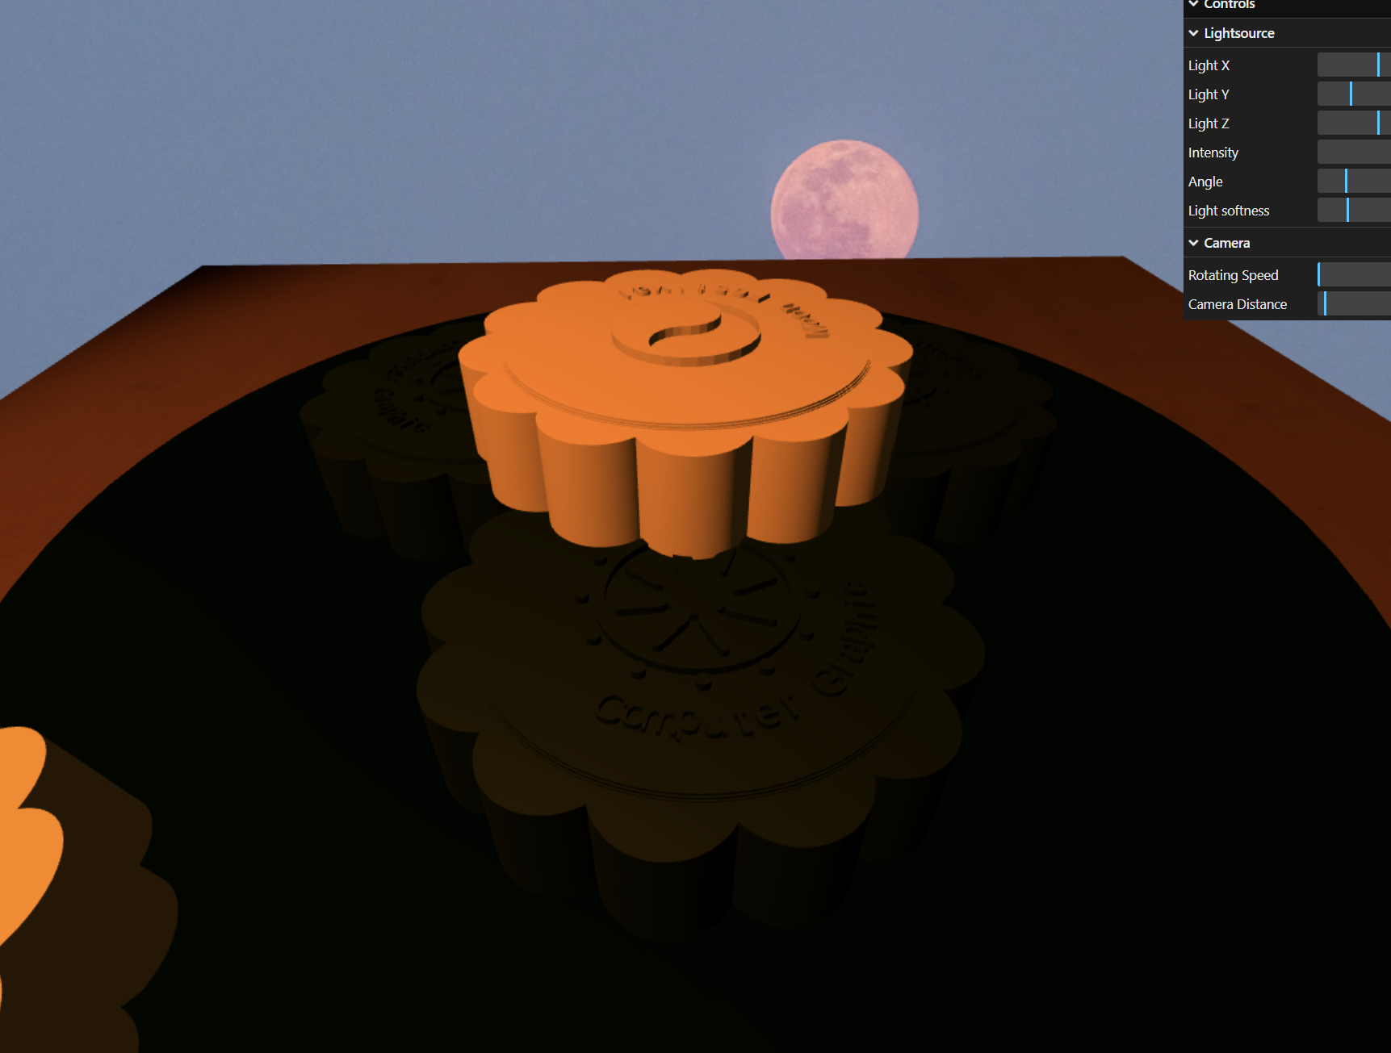
Renering and animate
Mooncakes with beautiful side patterns, Tai Chi motifs and engraved text for a realistic look and feel.
Animated by rotating the mooncake to create different shadows in the light.

Slide 10
Thank you for listening.

